Slide 1
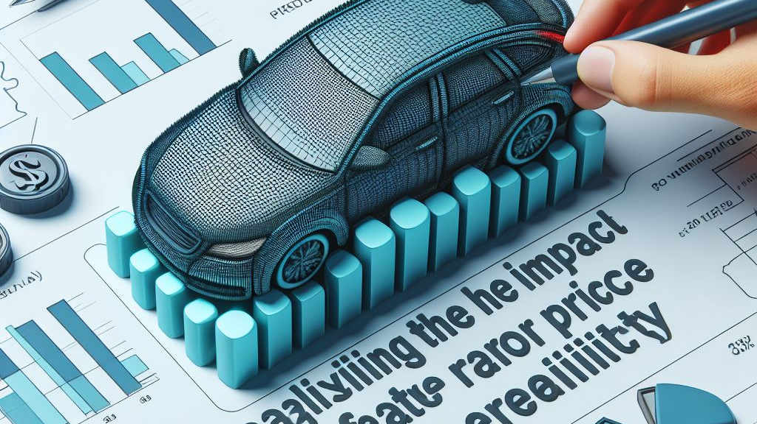

Analyzing the Impact of Car Features on Price and Profitability
By: AFZAL ALAM

Slide 2

INDEX:
PROJECT DESCRIPTION
DATASET
APPROACH
TECH –USED
INSIGHTS
CONCLUSION
RESULTS

Slide 3

PROJECT DESCRIPTION
The automotive industry has been rapidly involving over past few decades with a growing focus on fuel efficiency, environmental sustainability and technology innovation. With increasing competition in market manufactures wants to change consumer’s landscape
This project aims to analyze the car features that effect the manufacturers car’s price. As a Data Analyst, the client has asked that how can a car manufacturer optimize pricing and product development decisions to maximize the profitability while meeting consumer demand

Slide 4

Data set:
Car Features on Price and Profitability
PLEASE DOWNLOAD👆🏻 DATA FOR PERFECT RESULT

Slide 5

Approach
This project utilized descriptive statistics, visualization techniques, and modeling to analyze the car dataset and address the business questions.
Visualization techniques such as pivot tables, charts, and plots were used to represent the data visually and identify patterns and trends.
Regression analysis was performed to identify the key variables affecting car prices

Slide 6

tEch-used: All The Analysis Has Been Done On Excel Sheet(office 365), Excel As Tool Used To Create All Visualization And Graphs To Better Understanding The Result.

Slide 7
TASK 1: How does the popularity of a car model vary across different market categories?
For this task, Market categories were Consolidated. By grouping similar market categories together, we simplify the chart. For example, grouping of "Crossover, Diesel" and "Crossover, Flex Fuel" under a broader category called "Crossover - Fuel Type" or "Crossover - Diesel/Flex Fuel." Similarly, you can consolidate other market categories based on similarities
From below line chart we can in market category Hatchback and Fuel Flex are the highest populated and having highest number of car

Slide 8
TASK 2: What is the relationship between a car's engine power and its price?
By visualizing the data points on the scatter chart, we can observe the overall pattern or trend between engine power and price.
The trendline is providing the insight that there is a positive correlation between engine power and price and the degree to which they are related
From Scatter plot we can see cars which have high engine power having higher price. Thus, car’s power increase car’s price will also increase

Slide 9
TASK 3: Which car features are most important in determining a car's price?
Regression analysis allows us to analyze the relationship between the dependent variable (car price) and multiple independent variables (car features). By analyzing the coefficient values obtained from the regression analysis, we can assess the impact of each variable on the car's price.
From below Bar chart we can see Engine Cylinders having the strongest relationship with the MSRP

Slide 10
TASK 4: How does the average price of a car vary across different manufacturers?
In Task 4.A, a pivot table was created to calculate the average price of cars for each manufacturer. The pivot table aggregates the data and summarizes the average price based on the manufacturer. This provides a comprehensive overview of the average price range associated with each manufacturer.
In Task 4.B, a bar chart or a horizontal stacked bar chart was generated to visually represent the relationship between the manufacturer and the average price. The bar chart allows for easy comparison between different manufacturers, showcasing the variations in average prices across the industry
From below Bar chart we can see Car brand Bugatti and Bentley having the highest average price

Slide 11
TASK 5: What is the relationship between fuel efficiency and the number of cylinders in a car's engine?
In Task 5.A, a scatter plot was created with the number of cylinders on the x-axis and highway MPG on the y-axis. there is a negative relationship between the number of cylinders in a car's engine and its fuel efficiency, as represented by highway MPG. As the number of cylinders decreases, the car tends to have lower fuel efficiency. This insight can be valuable for car manufacturers, buyers, and policymakers in understanding the impact of engine configuration on fuel consumption and making informed decisions related to vehicle efficiency and environmental considerations.
In Task 5.B,the correlation coefficient was calculated to quantify the strength and direction of the relationship between the number of cylinders and highway MPG. The correlation coefficient measures the degree of linear association between two variables. In this case, the correlation coefficient was found to be -0.62. The negative value indicates an inverse relationship.
From below scatter plot we can see that no of cylinders having 4 is giving maximum fuel efficiency. Fuel efficiency is inversely proportional to no. of cylinders, higher the no. of cylinder lower the fuel efficiency.

Slide 12

dashboard

Slide 13
Task 1: How does the distribution of car prices vary by brand and body style?
From below Stacked column chart we can see the body style of Chevrolet and Mercedes Benz having highest contribution in car’s price.

Slide 14
Task 2: Which car brands have the highest and lowest average MSRPs, and how does this vary by body style?
From below Clustered column chart we can see Coupe style of Bugatti and Convertible style of Maybach having highest no of average Car’s price

Slide 15
Task 3: How do the different feature such as transmission type affect the MSRP, and how does this vary by body style?
From scatter plot we see the automated convertible and automated manual coupe are highly contributing MSRP

Slide 16
Task 4: How does the fuel efficiency of cars vary across different body styles and model years?
From above line chart we can see as time increased fuel efficiency (Highway MPG) also increased of improved.

Slide 17
Task 5: How does the car’s horsepower, MPG, and price vary across different Brands?
From below Bubble chart we can see the car which have high engine hp their price are also getting high and cars which have high highway MPG their price getting low. Thus, higher the engine power higher the price.

Slide 18
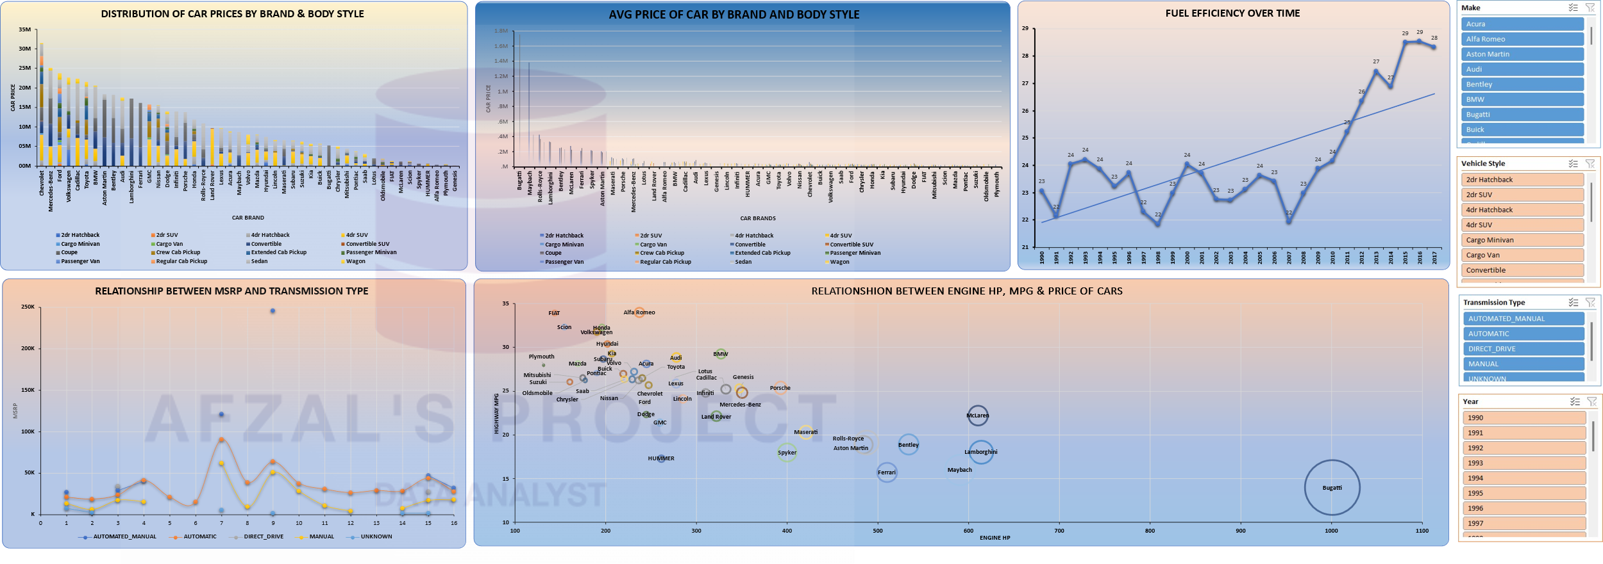
Dashboard

Slide 19

Through this project, I was able to understand the importance of Data Analytics in Car Feature Analysis as it provides valuable insights which helps in making Data-Driven Decisions.
In this project I was able to get insights like which features effects Car Price, relationship between Engine Cylinders and its fuel efficiency etc. I also got experience in Data Preprocessing like Data Cleaning, handling Outliers, Feature Engineering etc. in this project which can be communicated to relevant stakeholders as per the requirements

Slide 20

THANK YOU

